Slide 1
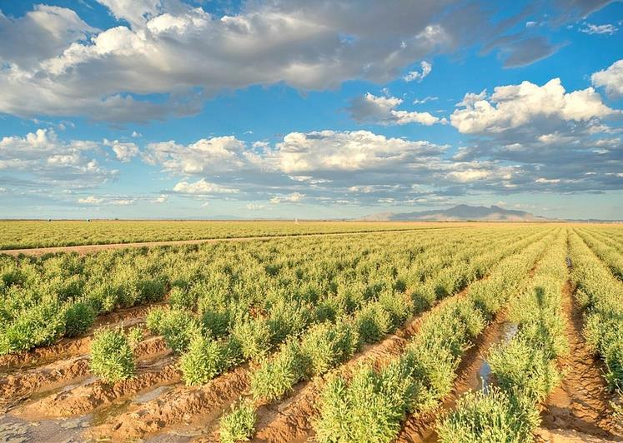

Indigenous Agriculture & Plant Cultivation in the Southwest
Arisbeth Ibarra Nieblas
The University of Arizona

Slide 2



Day 1
Agriculture
Objectives:
Explain the differences between wild and domesticated plants.
Provide examples of wild and domesticated plants and how they are used.
Describe the process of plant domestication by using examples found in the Southwest.
Compare Indigenous and non-indigenous agricultural practices in the Southwest.
Identify various domesticated and wild plants that are used for food by humans.

Slide 3
Group Discussion
In your groups, answer the following questions:
What are some edible wild plants that grow in the Sonoran Desert?
What are some types of foods or dishes that use plants found in the desert?

Slide 4


The Sonoran Desert provides food!
Edible (fit to be eaten) wild plants in the Sonoran Desert include:
  Cacti and cacti fruit
  Various non-cacti plants and shrubs that produce berries, peppers, seeds, and leafy greens.
  Trees—mesquite (pods), nuts, and acorns
  Wild Grasses
Indigenous people such as the Tohono O’odham and their predecessors, the Hohokam, have harvested desert plants for thousands of years and still do!
NOTE! NEVER EAT PLANTS YOU FIND UNLESS THEY HAVE BEEN IDENTIFIED BY AN EXPERT!!

Slide 5
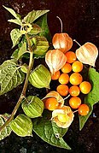
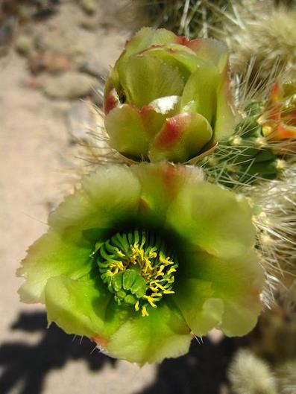
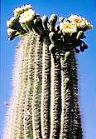
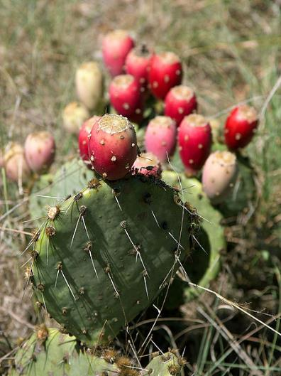
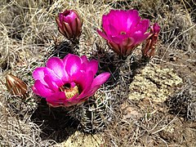
Wild edible plants in the Sonoran Desert
Groundcherry
Cholla cactus
Sahuaro cactus
Prickly pear cactus
Hedgehog cactus
NOTE! NEVER EAT PLANTS YOU FIND UNLESS THEY HAVE BEEN IDENTIFIED BY AN EXPERT!!

Slide 6
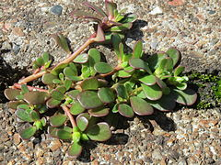
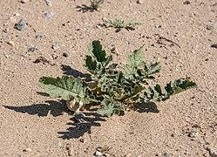
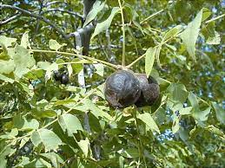
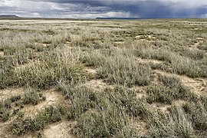
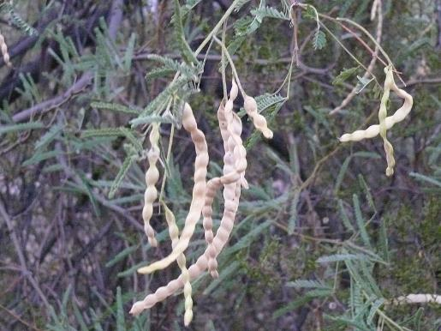
Wild edible plants in the Sonoran Desert
Purslanes
Mustards
Acorns & Nuts
Grasses
Mesquite pods
NOTE! NEVER EAT PLANTS YOU FIND UNLESS THEY HAVE BEEN IDENTIFIED BY AN EXPERT!!

Slide 7
Growing food in the Sonoran Desert
Challenges of growing food in the Sonoran Desert include:
  Dry and hot climate
  Low rainfall
  Water scarcity
  Soil (nutrients)
Indigenous people who lived in the Sonoran Desert used sophisticated methods to cultivate and harvest many desert plants.
  Settled near rivers
  Built irrigation canals
  Or used water harvesting techniques to retain water on the landscape.
  Gathered wild edible plants from the desert

Slide 8
Agriculture in the Sonoran Desert
Hohokam people lived in the Sonoran Desert for thousands of years
They are ancestors of modern Indigenous people in the southwestern U.S. and northern Mexico, like the O’odham peoples.
The first Europeans arrived in Arizona in 1539, less than 500 years ago.
Hohokam Irrigation. Visualization: Robert B. Ciaccio
Source: https://www.archaeologysouthwest.org/ancient-cultures/hohokam/

Slide 9
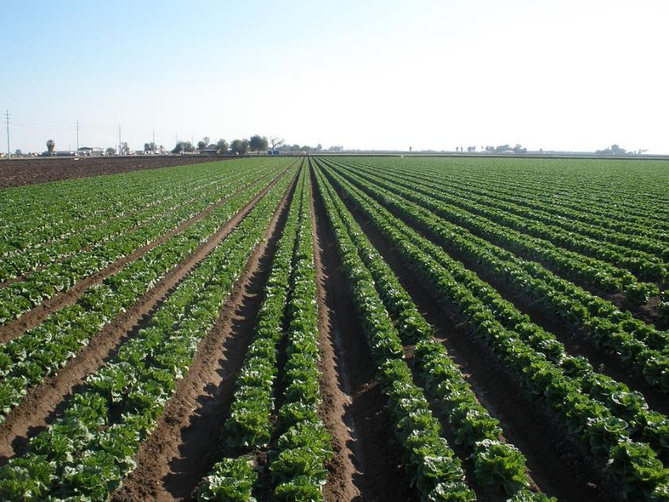
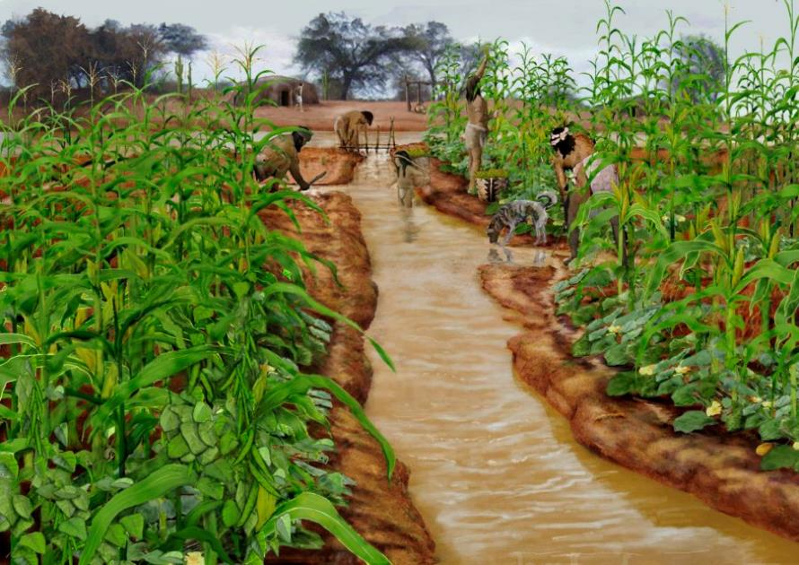
Comparing agriculture practices:
How many different plants are being grown in each field?
Non-indigenous agriculture: Lettuce field in Arizona
Hohokam Irrigation. Visualization: Robert B. Ciaccio
Source: https://www.archaeologysouthwest.org/ancient-cultures/hohokam/
Notes:
Free image https://pixabay.com/photos/arizona-lettuce-agriculture-plant-2608912/

Slide 10
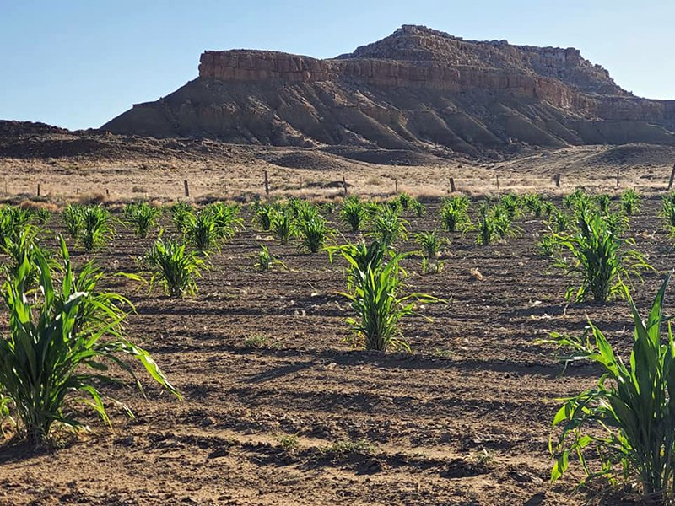
Comparing agriculture practices:
Which field resembles a natural Sonoran Desert environment?
Non-indigenous: Lettuce field in Arizona
Hopi agriculture: Corn field in Arizona
Photo by Michael Johnson
https://borderlore.org/its-gonna-be-okay-faith-and-climate-on-a-hopi-drylands-farm/
Notes:
Free image https://pixabay.com/photos/arizona-lettuce-agriculture-plant-2608912/

Slide 11
Domesticated plants in the Sonoran Desert
Until about 20,000 year ago, plants were wild and were gathered (not farmed or domesticated).
Plant domestication: when people collect seeds of wild plants and grow them in an area with the right conditions (enough sun, fertile soil, water) and harvest the crops for food.

Slide 12
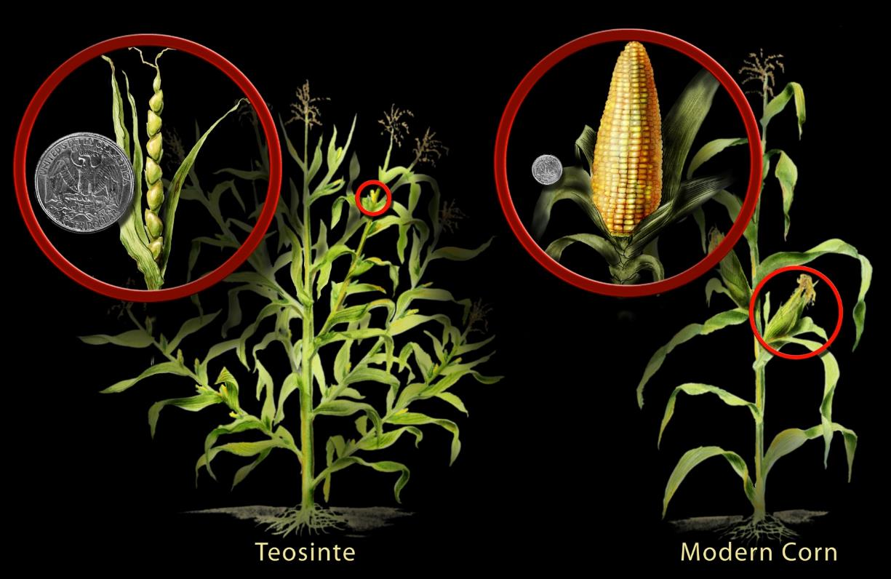
Indigenous people domesticated plants
Cultivated corn was domesticated from teosinte
Source: Nicolle Rager Fuller, National Science Foundation https://www.nsf.gov/news/news_images.jsp?cntn_id=104207&org=NSF

Slide 13
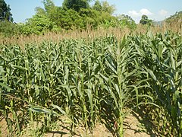
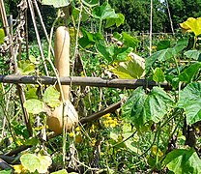
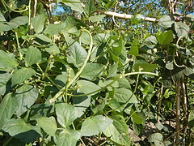
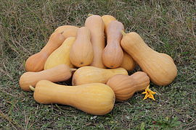
Domesticated plants in the Sonoran Desert
Corn
Gourd
Beans
Squash

Slide 14
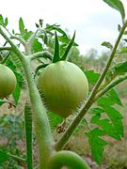
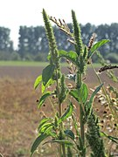
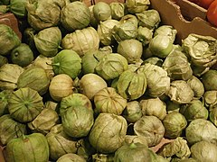
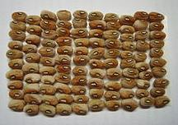
Domesticated plants in the Sonoran Desert
Tomato
Amaranthus
Tomatillo
Black-eyed peas

Slide 15
Individual activity
Supplies: paper and a pencil. Colored pencils are optional
Create a graphic organizer that shows at least 4 wild plants and the 4 domesticated plants that can be grown in the Sonoran Desert.

Slide 16






































Graphic organizer example
Wild plant name
Wild plant name
Wild plant name
Domesticated plant name
Domesticated plant name
Domesticated plant name

Slide 17
Exit Ticket or Discussion Prompt
1) List two advantages and two disadvantages of relying on primarily wild plants (gathering and foraging) for food.
2) List two advantages and two disadvantages for relying only on domesticated plants (agriculture) for food.

Slide 18
Day 2
Relationships
Objectives:
Compare and contrast traditional Hopi agriculture with modern industrial methods.
Categorize and apply the three types of symbiotic relationships between organisms.
Experience and interpret different ways that nature and science can be communicated through language..

Slide 19
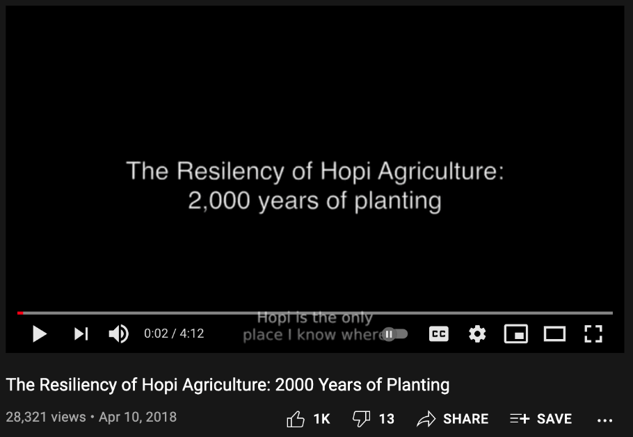
Individually answer questions about video
What is the main difference between Hopi and Western agricultural practices? Use example of growing the corn.
According to the Hopi farmer, which types of science does a Hopi farmer need in order to be successful?
What type of irrigation does the Hopi farmer use? How is this different from non-Native farming practices in Arizona?
https://www.youtube.com/watch?v=28gAFESNGMU

Slide 20
Video questions and answers
What is the main difference between Hopi and modern/industrial farming practices agriculture? Use example of growing the corn.
  Hopi farmers grow corn to conform to the environment, while modern/industrial farming practices farmers manipulate the environment to grow corn.
According to the Hopi farmer, which types of science does a Hopi farmer require to be successful?
  A Hopi farmer requires knowledge of an agronomist, hydrologist, and engineer.
What type of irrigation does the Hopi farmer use? How is this different from modern industrial farming practices in Arizona?
  The Hopi farmer does not use any irrigation, except for the rain. Western agriculture tends to use irrigation systems that rely on systems of tubes, pumps and sprays to apply water uniformly to the whole field.

Slide 21
Partner activity
Read the poem titled “Birth” by the author Ramson Lomatewama, a Hopi poet.
Answer and discuss the questions with a partner.

Slide 22
Title of poem:
Birth
Author:
Ramson Lomatewama
Young corn breaks ground
showered by rays of the rising sun.
They grow in happiness,
become filled with warmth.
Silky tassels grow long,
like my hair,
in search of new beginnings.
Tomorrow,
itaha taawa*
travels the longest day.
With pipe in hand,
we await our elders
who bring rain.
*itaha taawa: my uncle, the sun
Reference for poem:
Lomatewama, Ramson. Songs to the Corn: a Hopi Poet Writes about Corn. Rigby, 1997. https://edsitement.neh.gov/lesson-plans/lesson-2-hopi-poetry

Slide 23
Poem (Lomatewama) Questions
    1. Identify the factors mentioned in the poem that affect the growth of corn.
    Soil, sun, rain.
    2. What do you think the poet means by “the corn grows in happiness”?
    Possible answer: the corn is growing so it must be healthy and well taken care of.
    Possible answer: the corn is growing, and it is fulfilling its purpose to be a corn plant.
    3. Why do you think the poet refers to the sun as “uncle”?
    Possible answer: the poet who is also the farmer in the poem seems to have a deep connection with the land and nature. Sees the sun as an “uncle”, someone who helps him grow his food every day.
    4. Who are the “elders”? Why do you think the poet refers to them as “elders”?
    Possible answer: Rain clouds that bring moisture/rain. Rain has been around for millennia, like ancestors, and the clouds are respected for their gifts.

Slide 24



Relationships in nature
In what ways can relationships be positive or negative? Or supportive versus harmful?
Symbiosis is a relationship between two species in which at least one of the species benefits.
There are three different types of symbiotic relationships:
  Mutualism - two species benefit
  Commensalism - one species benefits, and the other is neutral
  Parasitism - one species benefits, and the other is harmed

Slide 25









Different symbiotic relationships in the Sonoran Desert
  Mutualism - two species benefit
  Commensalism - one species benefits, and the other is neutral
Cactus wren builds a nest in a palo verde tree
  Parasitism - one species benefits, and the other is harmed
A flea living on a coyote
Bee and saguaro flower

Slide 26
Different symbiotic relationships in the Sonoran Desert
  Commensalism - one species benefits, and the other is neutral
Commensalism: Cactus wren builds nest (+), palo verde tree is not harmed (=)
  Parasitism - one species benefits, and the other is harmed
  Mutualism - two
  species benefit
Parasitism: flea feeds on blood (+), coyote loses blood and weakens (-)
Mutualism: Bee feeds on pollen (+), flower gets pollinated (+),

Slide 27
Partner activity
Read the following quotes from the book titled Braiding Sweetgrass: Indigenous Wisdom, Scientific Knowledge and the Teachings of Plants by the author Robin Kimmerer.
Answer and discuss the questions with a partner.

Slide 28
Title of book:
Braiding Sweetgrass: Indigenous Wisdom, Scientific Knowledge and the Teachings of Plants
Author:
Robin Kimmerer, member of the Potawatomi Nation, Professor, Scientist, PhD in Botany
“For millennia, from Mexico to Montana, women have mounded up the earth and laid these three seeds in the ground, all in the same square foot of soil. When the colonists on the Massachusetts shore first saw indigenous gardens, they inferred that the savages did not know how to farm. To their minds, a garden meant straight rows of single species, not a three-dimensional sprawl of abundance. And yet they ate their fill and asked for more, and more again.”
“Native people speak of this gardening style as the Three Sisters.”
“The corn stands eight feet tall; rippling green ribbons of leaf curl away from the stem in every direction to catch the sun…The bean twines around the corn stalk, weaving itself between the leaves of corn, never interfering with their work…Spread around the feet of the corn and beans is a carpet of big broad squash leaves that intercept the light that falls among the pillars of corn. Their layered spacing uses the light, a gift from the sun, efficiently, with no waste.”
“The corn takes care of making light available; the squash reduces weeds.”
“Beans are members of the legume family, which has the remarkable ability to take nitrogen from the atmosphere and turn it into usable nutrients. But they don’t do it alone…When a bean root meets a microscopic rod of Rhizobium underground, chemical communications are exchanged and a deal is negotiated. The bean will grow an oxygen-free nodule to house the bacterium and, in return, the bacterium shares its nitrogen with the plant. Together, they create nitrogen fertilizer that enters the soil and fuels the growth of the corn and the squash, too.”
Reference for quotes:
Kimmerer, Robin. Braiding Sweetgrass : Indigenous Wisdom, Scientific Knowledge and the Teachings of Plant. Milkweed Editions. http://ebookcentral.proquest.com/lib/uaz/detail.action?docID=1212658.

Slide 29
Book Excerpt (Kimmerer): Questions
    Use the information in the first paragraph to contradict the idea that Native Americans were did not know how to use the land as often stated by colonists.
      Native Americans had a farming style that was a “sprawl of abundance”, and it provided enough food for them and for the colonists. Their farming style was different from what the colonist/Europeans were used to, but it was and is a very successful farming style.
    2. Name the 3 different plants mentioned in the quotes. Why do you think they are
    referred to as the Three sisters?
    Corn, beans, and squash. Relationships, protection, supporting the growth of one
    another.
    3. Identify the factors mentioned in the quotes that affect the growth of the plants.
    Sunlight, nitrogen, and bacteria.

Slide 30
Book quote questions and answers
    4. Which type of symbiotic relationship (mutualism, commensalism, and parasitism) exists between the three plants? Explain your answer.
Mutualistic relationship because the three plants benefit from one another but also help one another. The bean plant provides nitrogen which plants need. The corn provides the structure the bean plant can climb on and catch the sunlight between the spaces of the corn leaves. The squash plant helps to reduce weeds by covering the ground around the corn and bean.
    5. Which type of symbiotic relationship (mutualism, commensalism, and parasitism) exists between the bean plant and the bacteria? Explain your answer.
Mutualistic relationship because the bean plant provides the nodules that keep oxygen away so the bacteria can do its job. The bacteria convert nitrogen in the atmosphere into useable nitrogen for the bean plant.

Slide 31


Arisbeth Ibarra Nieblas
University of Arizona
Arisbeth Ibarra Nieblas grew up in Sonora, Mexico, in a town on the Gulf of California. She obtained her bachelor’s degree in chemical engineering at the Technological Institute of Sonora (ITSON), Ciudad Obregon, Mexico. Living in semi-arid regions her whole life, Arisbeth learned first-hand about water being a finite and vulnerable resource which catapulted her pursuit of water issues-related work and graduate studies. She is a fourth-year doctoral student in the Environmental Engineering Program at the University of Arizona. Her graduate research involves persevering water delivery infrastructure by developing a corrosion monitoring system. The system will monitor two measurements: (1) water quality in time (flow, pressure, conductivity, temperature, dissolved oxygen, and pH) and (2) the metal corrosion rate in time using a power supply that measures an electrical current. Also, Arisbeth is a fourth-year Sustainable Bioeconomy for Arid Regions (SBAR) Fellow, where she works developing and teaching science lessons and experiments to middle school students.
Any opinions, findings, conclusions, or recommendations expressed in this PowerPoint lesson are those of the author(s) and do not necessarily reflect the view of the U.S. Department of Agriculture. Grant # 2017-68005-26867.

